Slide 2
Why Many Companies Fail ?

Slide 3
BUSINESS ENVIRONMENT ?
Opportunities
Saturation
Concentration

Slide 4
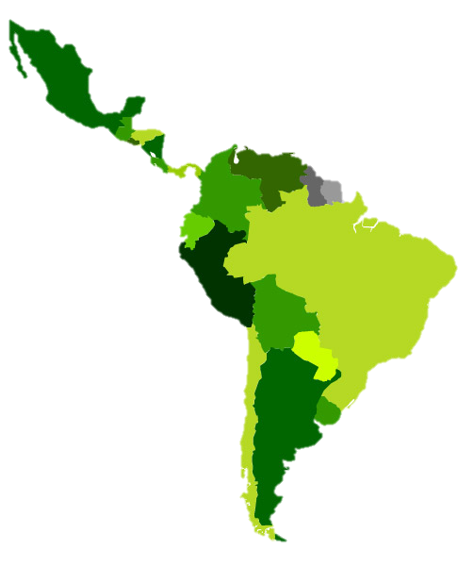
STRENGTHS
Low Productivity
Economic Performance
COLOMBIA
Infrastructure
Democratic Maturity
Informal Employment
Multilatinas
Inequality and poverty
High demand for commodities
CHALLENGES
Higher domestic consumption
Source: Interamerican Development Bank

Slide 5
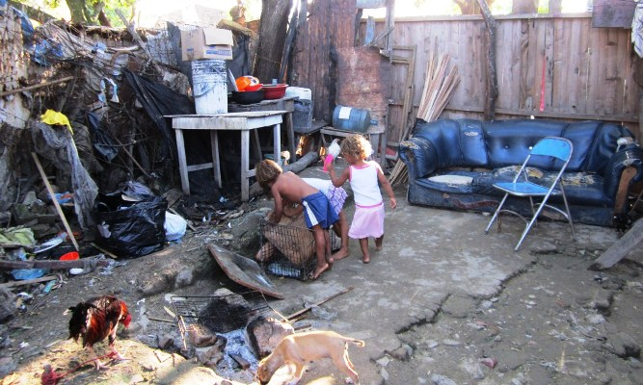
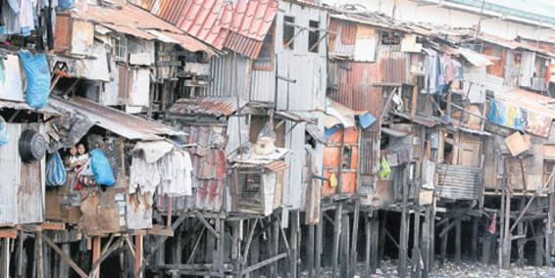
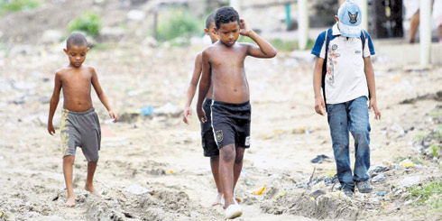
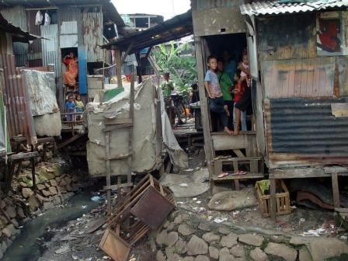
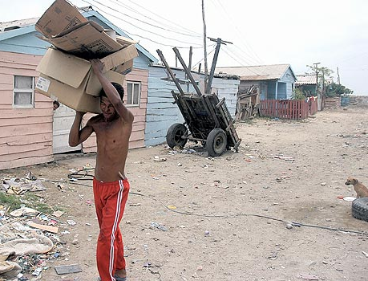

Slide 6
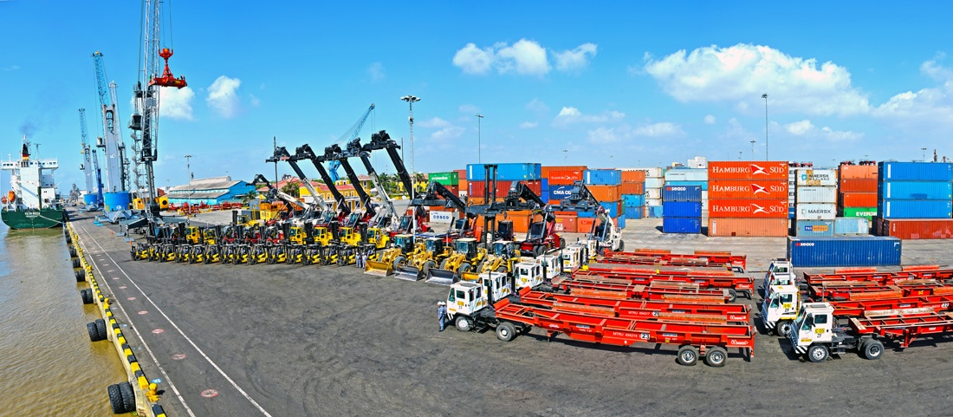

Slide 7
STRATEGIC LEVEL
EXECUTION LEVEL

Slide 13
BRAND ASSOCIATIONS

Slide 18
Brand Associations Networks
ASSOCIATION 3
ASSOCIATION 1
ASSOCIATION 2
CORE VALUES

Slide 20
MARKETING
1.MARKETING= 4Ps Vs Nivel Estratégico
3. MARKETING 1+ 1 = 2 vs 1+ 1 = 4
4. PLAN DE MERCADEO VS MERCADO
5. SEGMENTACIÓN vs OCASIONES DE CONSUMO-Cultura

Slide 24
Entrepreneurial Awareness
Incubation
Strengthening
Fundraising
ENTREPRENEURSHIP CENTER
20.583
Trained Students
Articulation with Academic Programs
5.584 users served
27 incubated companies
18 companies in incubation process
13 driven and promoted companies
12 funded companies $4,088 MM
ENTREPRENEURSHIP PROCESS

Slide 26
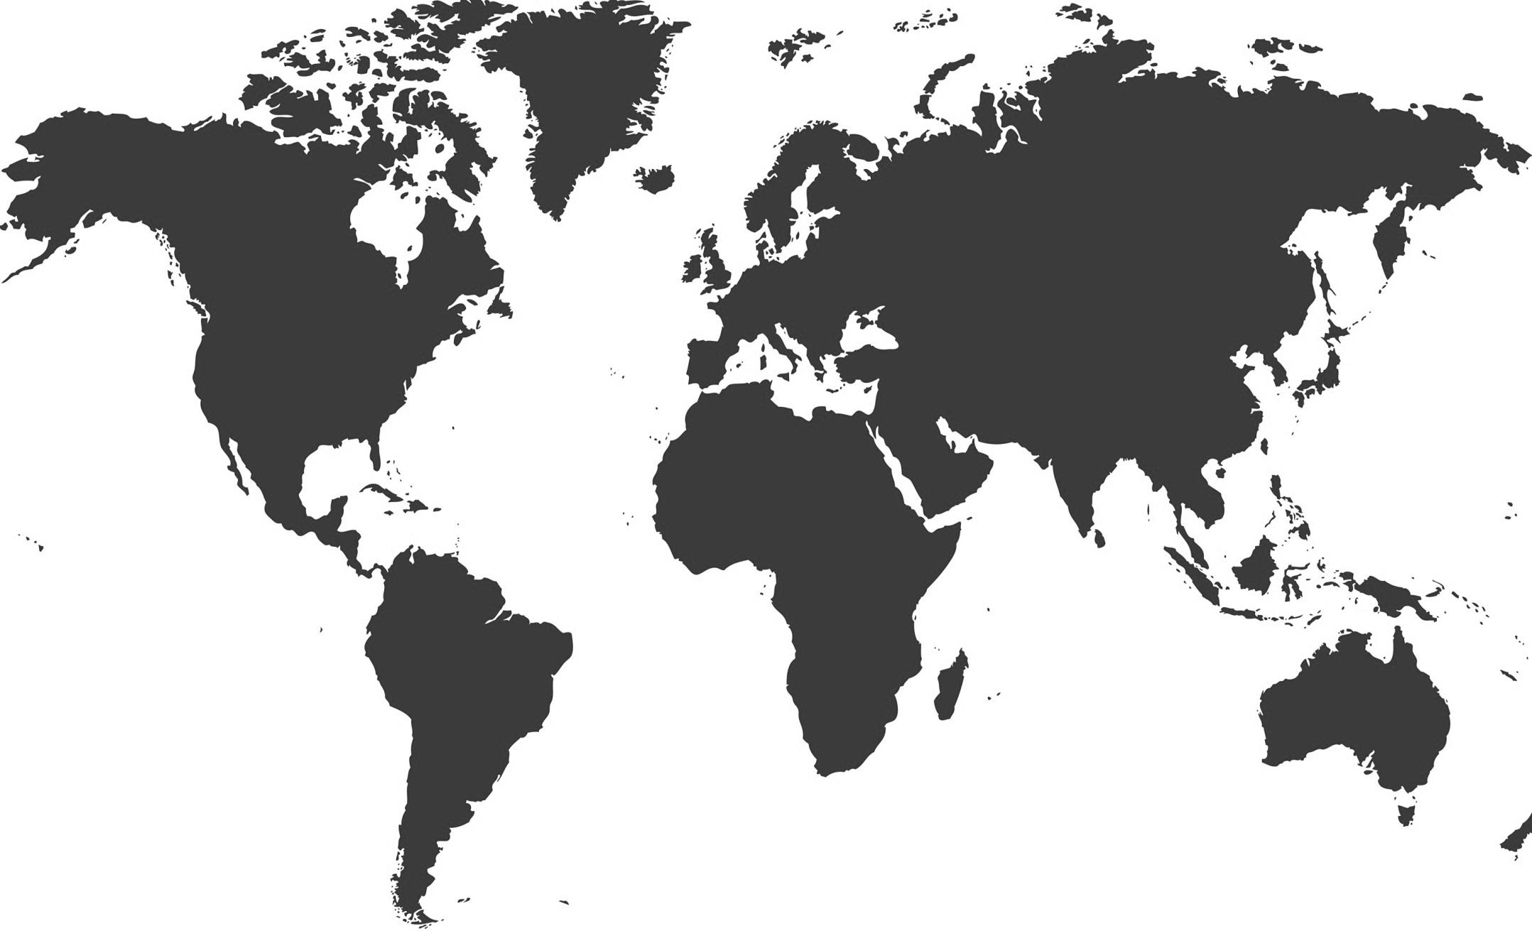
13.726 Business School
EUROPE
1985
ASIA
7132
NORTH
AMERICA
1782
AFRICA
719
LATIN
AMERICA
1923
OCEANIA
174
OCEANIA
185
Fuente: Business School Data Trends, Edition 2012 - AACSB
212 Accredited

Slide 27
1923 Business School in Latin America
COLOMBIA
33 Accredited
1,7%

Slide 28
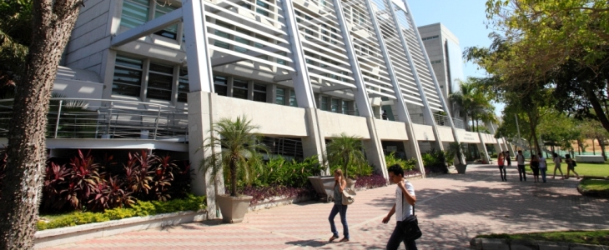
TOP 20 Latin American Business School
38
32
28
24
19
2014

Slide 29
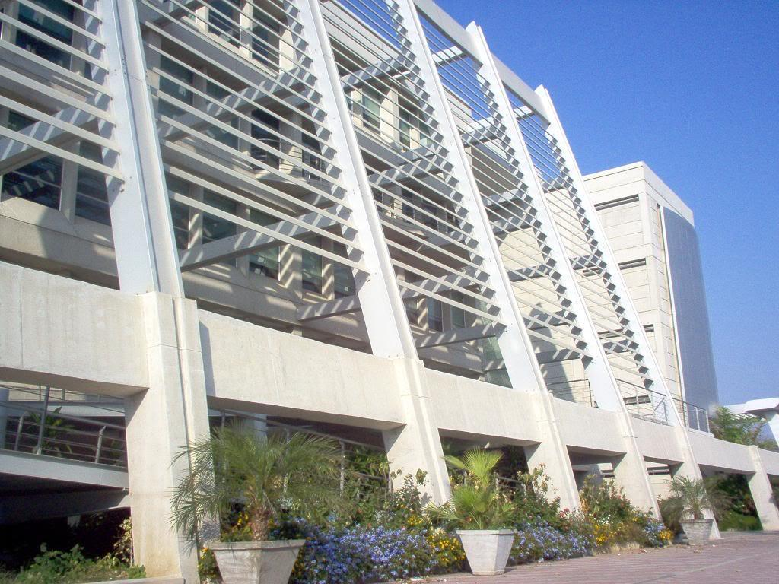
UNDERGRADUATE PROGRAMS
BUSINESS ADMINISTRATION
ACCOUNTING
INTERNATIONAL BUSINESS
GRADUATE PROGRAMS
MBA
MASTER OF FINANCE
MASTER OF MARKETING
PhD IN MANAGEMENT

Slide 30
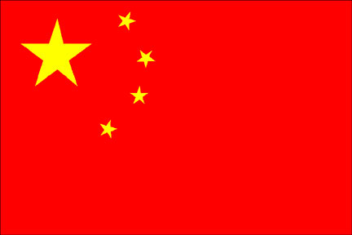
CULTURE

Slide 31
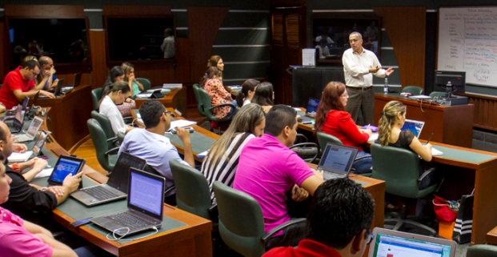
International Students
International Faculty
Courses taught in English and other languages
Curriculum reform adjusted to international business trends
AMBA International Accreditation
INTERNATIONAL EDUCATIONAL EXPERIENCE

Slide 32
STRATEGY AND COMPETITIVENESS CENTER
Supports the identification of Potential markets
Provides tools for developing market intelligence
Offers Export Training Programs

Slide 33
NIIF PARA PYMES
Support in the implementation of international Financial Reporting Standards

Slide 34
We educate Global Leaders Who Transform the Business World

