Slide 1
Ecosistema de Emprendimiento – Mitos y Verdades

Slide 2
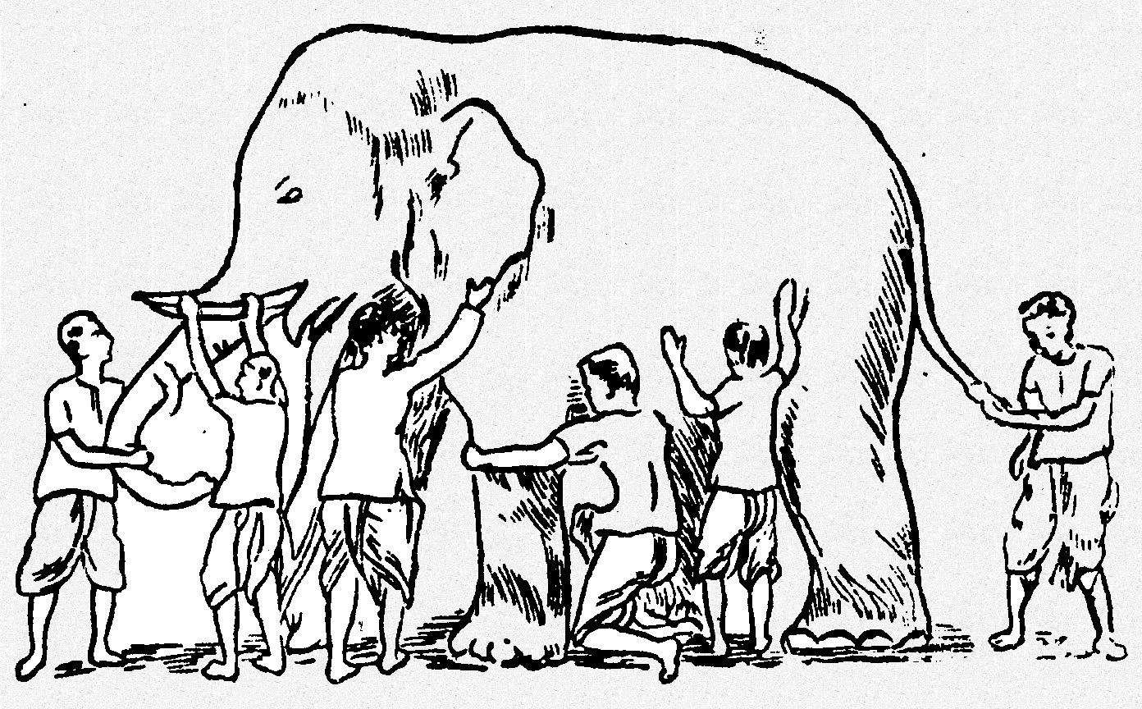
La historia del elefante y los 6 hombres ciegos
¿Qué es el Ecosistema de Emprendimiento?
Notes:
Redes de Inversionistas Angeles
Aceleradores
Cluster
Capital de Riesgo
Incubadoras
Politicas Publicas para Pymes
Once upon a time, there lived six blind men in a village. One day the villagers told them, "Hey, there is an elephant in the village today."
They had no idea what an elephant is. They decided, "Even though we would not be able to see it, let us go and feel it anyway." All of them went where the elephant was. Everyone of them touched the elephant.
"Hey, the elephant is a pillar," said the first man who touched his leg.
"Oh, no! it is like a rope," said the second man who touched the tail.
"Oh, no! it is like a thick branch of a tree," said the third man who touched the trunk of the elephant.
"It is like a big hand fan" said the fourth man who touched the ear of the elephant.
"It is like a huge wall," said the fifth man who touched the belly of the elephant.
"It is like a solid pipe," Said the sixth man who touched the tusk of the elephant.
They began to argue about the elephant and everyone of them insisted that he was right. It looked like they were getting agitated. A wise man was passing by and he saw this. He stopped and asked them, "What is the matter?" They said, "We cannot agree to what the elephant is like." Each one of them told what he thought the elephant was like. The wise man calmly explained to them, "All of you are right. The reason every one of you is telling it differently because each one of you touched the different part of the elephant. So, actually the elephant has all those features what you all said."
"Oh!" everyone said. There was no more fight. They felt happy that they were all right.
The moral of the story is that there may be some truth to what someone says. Sometimes we can see that truth and sometimes not because they may have different perspective which we may not agree too. So, rather than arguing like the blind men, we should say, "Maybe you have your reasons." This way we don’t get in arguments. In Jainism, it is explained that truth can be stated in seven different ways. So, you can see how broad our religion is. It teaches us to be tolerant towards others for their viewpoints. This allows us to live in harmony with the people of different thinking. This is known as the Syadvada, Anekantvad, or the theory of Manifold Predictions.

Slide 3
Ecosistema de Emprendimiento

Slide 4
Emprendedor/ Emprendimiento
Tomar riesgos
Richard Cantillon (1734)

Slide 5
“el proceso por medio del cual oportunidades para crear futuros bienes y servicios son descubiertos, evaluados y explorados”
Shane & Venkatamaran (2000)
Notes:
“the process by which opportunities to create future goods and services are discovered, evaluated and exploited‟

Slide 6
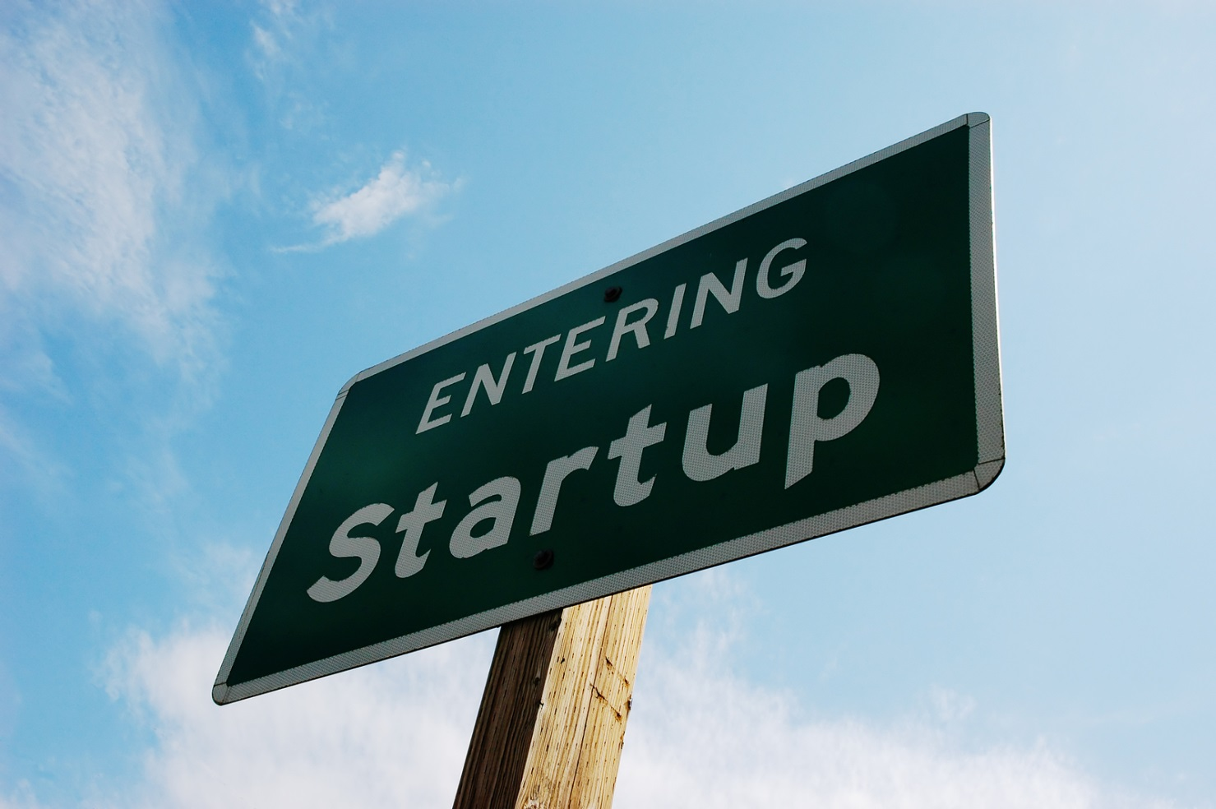
Mito # 1
Emprendimiento = Start - Up

Slide 7
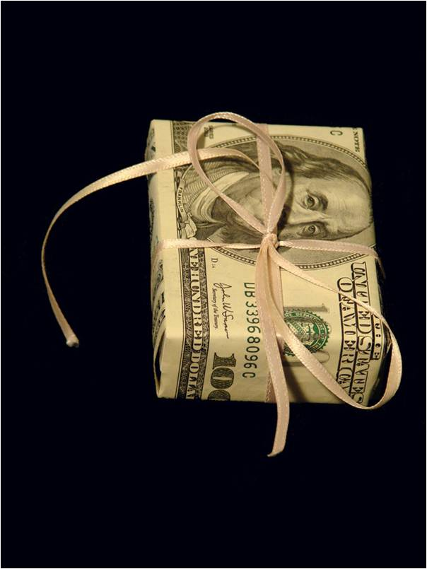
Verdad # 1
Emprendimiento = Creación y Captura de Valores

Slide 8
Implicaciones # 1
Start – up & Scale-up
Notes:
El foco no debería estar solamente en la creación de nuevas empresas, sino también como promover el crecimiento de las empresas existentes.

Slide 9
Ecosistema de Emprendimiento

Slide 10
Ecosistema
Ecología
Sir Arthur George Tansley (1871-1955)

Slide 11
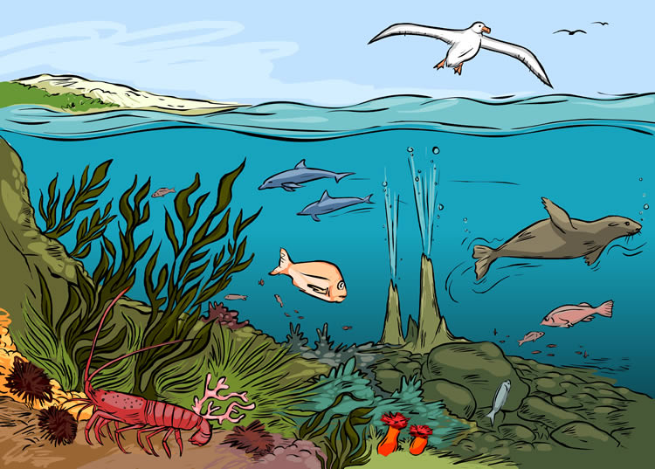
Ecosistema
Notes:
An ecosystem exists when numerous species of flora and fauna interact in a dynamic, self-adjusting balancing act
all the plants and living creatures in a particular area considered in relation to their physical environment

Slide 12
Ecosistema
Notes:
An ecosystem exists when numerous species of flora and fauna interact in a dynamic, self-adjusting balancing act
all the plants and living creatures in a particular area considered in relation to their physical environment

Slide 13
Ecosistema
Notes:
An ecosystem exists when numerous species of flora and fauna interact in a dynamic, self-adjusting balancing act
all the plants and living creatures in a particular area considered in relation to their physical environment

Slide 14
Ecosistema de Emprendimiento
“un conjunto diverso de actores interdependientes dentro de una región geográfica que influye la formación y la eventual trayectoria de un grupo entero de actores y potencialmente la economía como un todo”
Cohen (2006)
Notes:
diverse set of inter-dependent actors within a geographic region that influence the formation and eventual trajectory of the entire group of actors and potentially the entire economy

Slide 15
Ecosistema de Emprendimiento
“un conjunto diverso de actores interdependientes dentro de una región geográfica que influye la formación y la eventual trayectoria de un grupo entero de actores y potencialmente la economía como un todo”
Cohen (2006)
Notes:
diverse set of inter-dependent actors within a geographic region that influence the formation and eventual trajectory of the entire group of actors and potentially the entire economy

Slide 16
Mito # 2
Ecosistemas de Emprendimiento = Emprendedores o Universidades o Inversionistas

Slide 17
Verdad # 2
Ecosistemas de Emprendimiento = Conjunto de diversos actores interdependientes

Slide 18
Implicaciones # 2
Inversio-nistas
Empresas existentes
Incuba-doras
Entidades Públicas
Emprendedores
Asso-ciaciones
Accele-radoras
Universi-dades
Consultores

Slide 19
Implicaciones # 2
Inversio-nistas
Empresas existentes
Incuba-doras
Entidades Públicas
Emprendedores
Asso-ciaciones
Accele-radoras
Universi-dades
Consultores

Slide 20
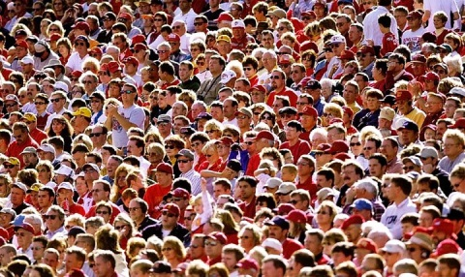
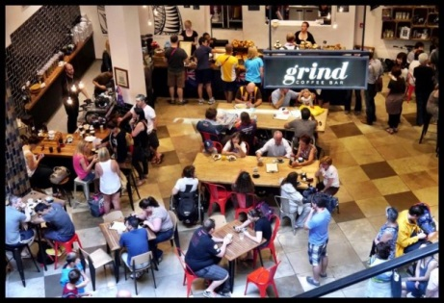
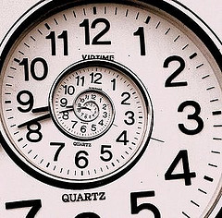
Implicaciones # 2
Inversio-nistas
Empresas existentes
Incuba-doras
Entidades Públicas
Emprendedores
Asso-ciaciones
Accele-radoras
Universi-dades
Consultores

Slide 21
Ecosistema de Emprendimiento
“un conjunto diverso de actores interdependientes dentro de una región geográfica que influye la formación y la eventual trayectoria de un grupo entero de actores y potencialmente la economía como un todo”
Cohen (2006)
Notes:
diverse set of inter-dependent actors within a geographic region that influence the formation and eventual trajectory of the entire group of actors and potentially the entire economy

Slide 22
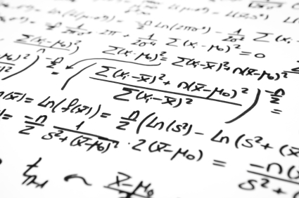
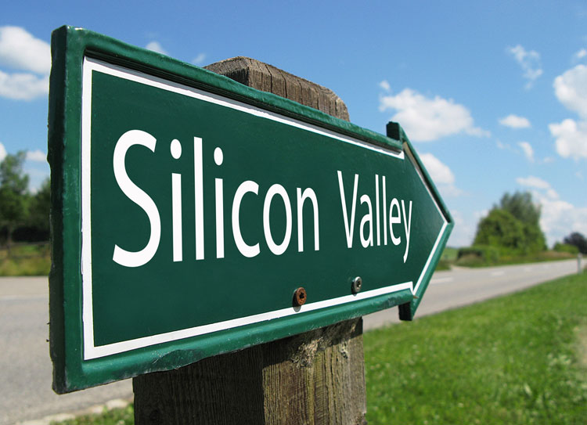
Mito # 3
Ecosistema de Emprendimiento = se puede crear un nuevo Silicon Valley

Slide 23
Verdad # 3
Ecosistemas de Emprendimiento = La base son las condiciones locales

Slide 24
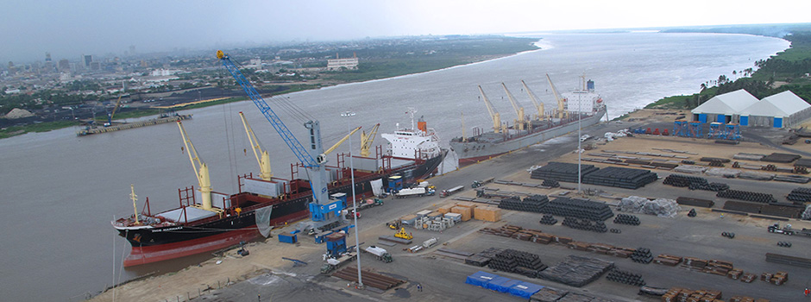
Implicaciones # 3
Condiciones locales

Slide 25
Ecosistema de Emprendimiento
“un conjunto diverso de actores interdependientes dentro de una región geográfica que influye la formación y la eventual trayectoria de un grupo entero de actores y potencialmente la economía como un todo”
Cohen (2006)
Notes:
diverse set of inter-dependent actors within a geographic region that influence the formation and eventual trajectory of the entire group of actors and potentially the entire economy

Slide 26
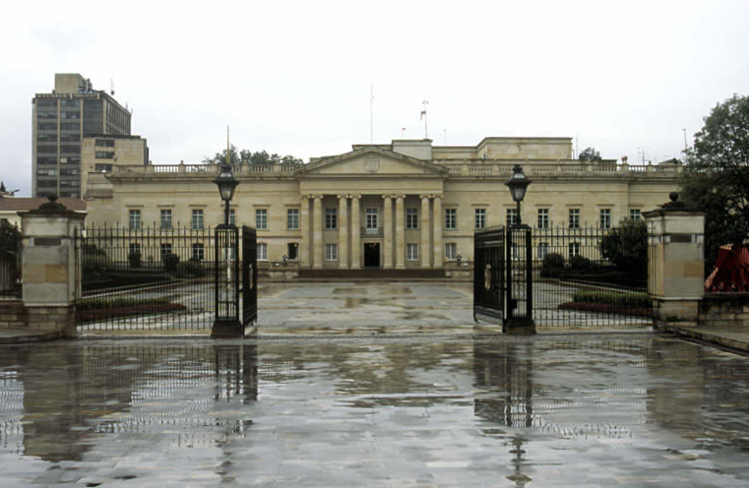
Mito # 4
Ecosistema de Emprendimiento =
Programa de Política Pública

Slide 27
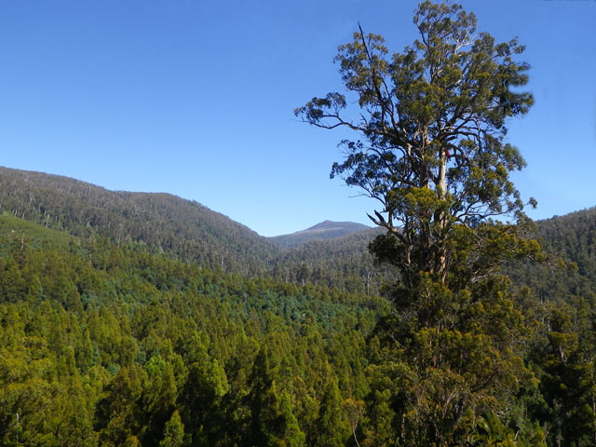
Verdad # 4
Ecosistemas de Emprendimiento = Ambiente prolifero para el emprendimiento

Slide 28
Implicaciones # 4
Empren-dimiento
Políticas Publicas
Financia-miento
Cultura
Supor-tes
Capital Humano
Merca-dos
Fuente: D. Isenberg
Crear un ambiente facilitador

Slide 29
Implicaciones # 4
Empren-dimiento
Políticas Publicas
Financia-miento
Cultura
Supor-tes
Capital Humano
Merca-dos
Fuente: D. Isenberg
Crear un ambiente facilitador
Notes:
Top down versus Bottom up

Slide 30
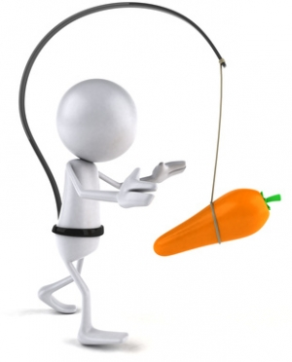
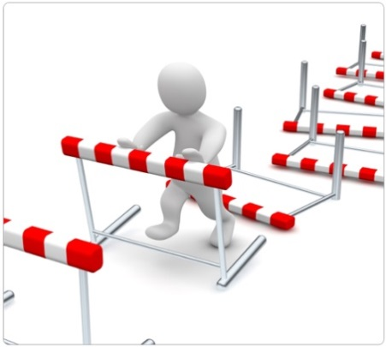
Implicaciones # 4
Empren-dimiento
Políticas Publicas
Financia-miento
Cultura
Supor-tes
Capital Humano
Merca-dos
Fuente: D. Isenberg
Crear un ambiente facilitador
Notes:
Top down versus Bottom up

Slide 31
Implicaciones # 4
Escuchar.
Escuchar.
Escuchar.

Slide 32
Mito # 5
Ecosistema de Emprendimiento =
Relación simple entre causa y efecto

Slide 33
Verdad # 5
Ecosistemas de Emprendimiento = Un sistema evoluciona

Slide 34
Implicaciones # 5
Trial and Error

Slide 35
Implicaciones # 5
Trial and Error - Sistemático

Slide 36
“Chance favors the prepared mind”
Louis Pasteur

Slide 37
¿Por qué hablamos de emprendimiento?

Slide 38
En los Estados Unidos (como ejemplo):
El salario promedio de fundadores de nuevas empresas se mantiene por debajo del salario como empleado 5 años después de la fundación
80% de los fundadores de nuevas empresas emplean ninguna otra persona
>50% de las nuevas empresas mueren 5 años después de su fundación

Slide 39
Mito # 6
Más Emprendimiento =
Más Desarrollo Económico

Slide 40
Verdad # 6
Emprendimiento impulsado por la innovación = Desarrollo Económico

Slide 41
Implicaciones # 6
No solamente calidad –
sino también cualidad

Slide 42
Implicaciones # 6
¿Como conectar innovación y emprendimiento?

Slide 43
Implicaciones # 6
Inversio-nistas
Empresas existentes
Entidades Públicas
Incuba-doras
Innovadores
Emprendedores
Asso-ciaciones
Accele-radoras
Universi-dades
Consultores

