Slide 1
Lecciones y oportunidades
Paula.duque@Microsoft.com

Slide 2
PASION

Slide 3
IDEA

Slide 5
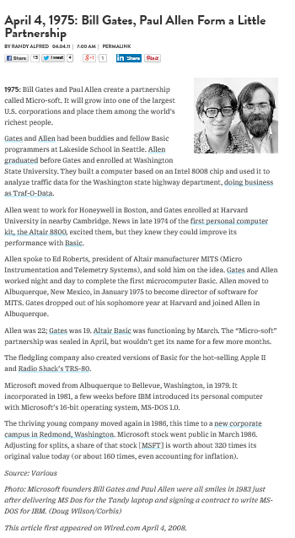
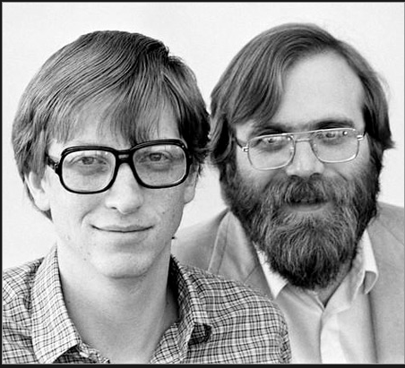
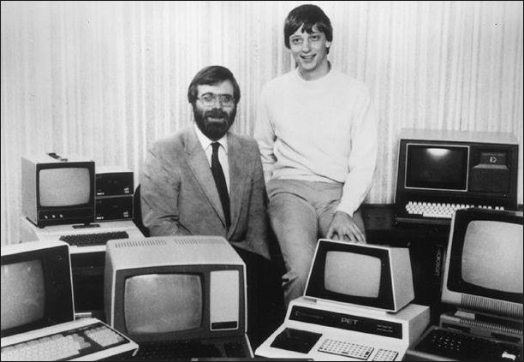
Todo empieza con una idea
Pasión
Disrupción
http://www.bing.com/images/search?q=imagenes+Bill+gates+y+paul+allen&qpvt=imagenes+Bill+gates+y+paul+allen&FORM=IGRE#view=detail&id=491687D6B390F1E03DFFAABC1A3D11B356DAD794&selectedIndex=0
Notes:
Highlights
Xx grants in xx countries
YouthSpark live transition successful, 35 events complete in 25 countries
YouthSpark on Global Giving $2.3m donated, 90k youth impacted, 65 countries
YouthSpark Hub re-launch
Computer Science activities taking off around the world

Slide 6
"Sabíamos que montar una empresa significaría sacrificio. Pero también nos dábamos cuenta de que teníamos que hacerlo o perderíamos para siempre la oportunidad de hacer algo en software para microcomputadoras“
Bill Gates
http://www.negociosyemprendimiento.org/2013/01/frases-bill-gates-empresas-negocios-gestion.html

Slide 7
PIENSA
EN
GRANDE

Slide 8
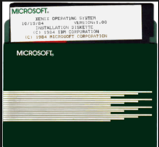
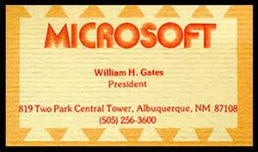
Hay que creerse el cuento
Convicción
Oportunidad
Notes:
YouthSpark: One Step Further
EU Grand Coalition for Digital Jobs
MEA Employability Portals
LATAM: Regional Youth Policy
U.S. xx States now recognize Computer Science as a math or science credit
We Speak Code Malaysia: U.S. President Obama and Malaysian Prime Minister

Slide 9
La tormenta perfecta habilita lo empresarial
Movilidad
nube
Social
Mega datos
Notes:
Timing: 3 minutes
Key Points:
Four megatrends are emerging that we believe will be dominant forces of change over the coming decade: mobility, social, cloud, and business intelligence (BI)/big data.
The four megatrends of mobility, social, cloud, and BI/big data will play a fundamental role in enabling businesses to re-evaluate and transform their business strategies.
The CIO is in an unprecedented position to contribute strategically to the business.
Script:
As we at Microsoft look across what is happening in the technology industry today and the many conversations that our account teams have had with hundreds of enterprise IT leaders, four megatrends are evident. These trends not only represent what is most important to our customers today, but what we feel are likely to be the dominant forces of change in the coming decade.
The proliferation of new device types, along with the connectivity of the cloud, is making us more mobile and changing the way we work and play.
As technology becomes more immersive, we also expect it to help us develop more personal and social connections with colleagues and customers.
The connectivity the cloud offers is changing what we expect from technology. With an always-on connection, apps can provide innovative new services with instant scalability and attractive economics.
While business intelligence (BI) has been important for a great number of years, the explosion in connected devices and apps is generating an exponential growth in data and the need to get better insights from “big data.”
At Microsoft we’re directly witnessing and experiencing these megatrends, but we’re not alone in our belief of their importance. According to IDC, “In 2012, the ICT industry's shift to its third major platform of growth — built on mobile, cloud, social, and big data technologies — will accelerate.” In contrast to what they refer to as the first (mainframe) and second (PC/server) platforms, they estimate that by 2020, “…enterprises’ highest-value leverage of IT will be driven by these third-platform technologies as well as an explosion of new solutions built on the new platform and rapidly expanding consumption of all of the above in emerging markets.”
Each of these technology megatrends will play a significant role in the enterprise of today and tomorrow.
They are putting your IT organization in an unprecedented position to contribute strategically to your business, using technology to support and drive business priorities.
They are also changing the status quo. Transforming your business by taking advantage of the new opportunities that these megatrends present can help you stay competitive in an expanding world of smaller, more nimble competitors.
These four megatrends are not only happening simultaneously, but are highly interconnected. Unlike other major shifts in technology where typically there has been one predominant trend (such as the introduction of mainframe and, later, client/server computing), businesses must address all four of these trends simultaneously.
In the social sphere, these trends are driving changes in how we work that give rise to new ways of getting things done inside the business.
65 percent of companies are deploying at least one social software tool today, and the trend is expected to continue as social networking becomes a ubiquitous part of daily work.
Mobile devices are proliferating, so much so that the average consumer uses four different devices in a day.
And remote workers have become a huge part of the work environment today, with 84 percent of organizations having remote workers.
And they are also driving changes in customer behavior, leading to the rise of the social customer, who expects to be engaged in new ways.
44 percent of consumers today complain about products and services by social networks, and they are more likely to accept what they hear through social networks over advertising.
20 percent of customers who complain by social media expect a response within one hour.
By embracing social technologies into the enterprise, CIOs can have a strategic impact both inside and outside the business. Social networks have revolutionized how companies engage with their customers. As consumers increasingly conduct their lives through social networking, this has become an essential medium through which to reach them. Businesses that provide unique, interactive, personalized online social experiences will be best positioned to attract and retain new customers. Social technologies are equally essential inside the enterprise, where they provide powerful tools for collaboration and building communities. Just think of the potential for harnessing and developing new business ideas when your employees are all connected online.
Additional Information:
Neisser, Drew. “Twelpforce: Marketing that Isn’t Marketing.” Fast Company. May 17, 2010. http://www.fastcompany.com/1648739/marketing-that-isn-t-marketing
“Gartner Executive Programs' Worldwide Survey of More Than 2,300 CIOs Shows Flat IT Budgets in 2012, but IT Organizations Must Deliver on Multiple Priorities.” Gartner, Inc. January 18, 2012. http://www.gartner.com/it/page.jsp?id=1897514
Gens, Frank. "IDC Predictions 2012: Competing for 2020.” IDC. Doc #231720. December 2011. http://www.idc.com/getdoc.jsp?containerId=231720
Qualman, Erik. “Social Media Revolution.” Socialnomics.com. May 5, 2010. http://www.socialnomics.net/2010/05/05/social-media-revolution-2-refresh/

Slide 10
Historias de éxito

